Slide 1


International Innovation Hackathon
Theme- Healthcare
Idea Title- Jeevanti: Healthcare
Team Name- Code Catalyst

Slide 2
Jeevanti: Healthcare
Jeevanti is an AI-powered healthcare platform that provides personalized, accessible medical assistance, including disease prediction, video consultations, and medication suggestions, especially for underserved communities.
Limited Access to Healthcare in Undeveloped Areas:
According to ASER 2021, 67.6% of Indian house holds have smartphones which can help our product/service to reach undeveloped areas. Countries best doctors will be accessible on our app.
Lack of Personalized Care:
Our AI-driven platform will utilize individual patient data such as medical history, lifestyle factors and real-time health metrics to predict upcoming diseases and provide personalized care plans.
Increased waiting times and Inefficient processes:
AI can prioritize urgent cases, assist healthcare providers in diagnosing complex conditions, and reduce the time for initial assessments. It will streamline the evaluation process, providing faster diagnosis and treatment recommendations.

Slide 3
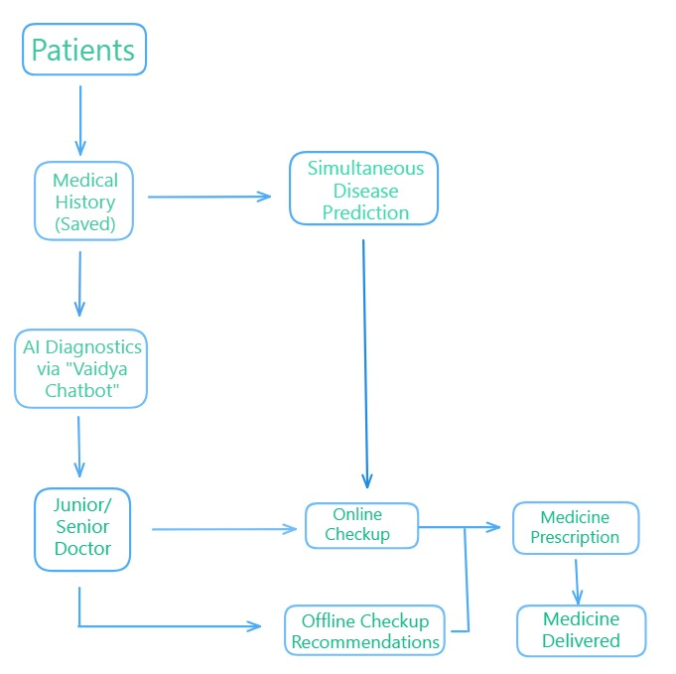
TECHNICAL APPROACH
Technologies Used:
Python
VS Code
Tenser flow
Open CV
NLTK
Machine Learning Models
Flask
Streamlit
GPT API’s
Workflow of our Application:

Slide 4
FEASIBILITY AND VIABILITY
Feasibility Analysis:
Jeevanti leverages scalable AI, telemedicine, and cloud services to provide affordable healthcare access. Increasing smartphone use and internet reach in remote areas make this solution practical. India's massive population represents a significant market for e-Healthcare services, offering potential for scale and impact.
Potential Challenges and Risks:
Implementing Jeevanti may face challenges such as limited internet connectivity in remote areas, user adoption barriers, and data privacy concerns. Ensuring AI model accuracy and regulatory compliance are also critical risks that need to be addressed for safe and effective healthcare delivery.
Strategies for Overcoming Challenges:
We will create offline features for limited internet access, engage communities for user adoption, and ensure data privacy through encryption and compliance. Regular AI updates will maintain accuracy, while collaboration with regulators will ensure adherence to healthcare standards.

Slide 5
IMPACT AND BENIFITS
Potential Impact on the Target Audience:
Our solution aims to enhance healthcare access and quality for underserved populations, leading to timely diagnoses and improved health outcomes. By integrating predictive models, we can identify at-risk individuals early, enabling proactive interventions. Ultimately, this approach fosters healthier communities and reduces healthcare disparities.
Benefits of the solution:
The solution enhances community health by providing timely access to quality care, reducing morbidity and mortality rates. It lowers healthcare costs through early diagnosis, easing financial burdens and boosting productivity. Additionally, it supports sustainable practices via telehealth, minimizing travel and reducing carbon footprints. Finally, it drives innovation in healthcare delivery through predictive analytics, fostering patient engagement and improved outcomes.

Slide 6
RESEARCH AND REFERENCES
Video Demonstration Link Of Our App Jeevanti: https://youtu.be/VPpaPRlNUec
Research Articles For AI Models:
Breast Cancer: https://www.google.com/amp/s/www.business-standard.com/amp/india-news/ai-detects-breast-cancer-5-years-in-advance-anand-mahindra-reacts-124072900802_1.html
Heart Disease: https://www.mayoclinic.org/departments-centers/ai-cardiology/overview/ovc-20486648

